Slide 1
Easify
Team - 3
Neeraj Kulkarni
Janvi Ramani
Anvai Patil
Dhruvil Shah
Varun Patel
Guided By
Professor Henry Wong

Slide 2





Agenda
Introduction
Team members
Problem Statement
Project Description
Personas
Technologies and Design
Front-end
Back-end
Design Architecture
Sprint 4 recap & Sprint 5
Sprint Backlog
Test Cases
Burndown Chart
Velocity Chart
Retrospective
Results and Future work
Sprint 6 Use Stories
Sprint 5 Results

Slide 3
Team Members - Roles and Responsibilities
Neeraj Kulkarni - Backend Developer
Janvi Ramani - Backend Developer
Anvai Patil - Frontend Developer
Dhruvil Shah - Scrum Master, Cloud Engineer
Varun Patel - Full Stack Developer

Slide 4
Problem Statement
Using current scrum application , we can see that there can be end date failure in which people fail to finish the project. There can be situation such that people can be cooperative or committed.
Sometimes daily meetings can frustrate team members and they do not like to perform daily meetings.
Using the remote or onsite project, there can be situation such that one person transfer to another company in middle of project. In this situation, it is difficult to complete project and group will have negative impact.

Slide 5
Project Description
Easify Overview
We are designing an application called Easify. Easify is an application that helps you manage scrum-based projects easily and effectively.
To manage the project, Easify will provide Product Backlog management and Sprint Backlog management features.
In addition, users can use Easify’s Share Images and Chat features to share each other work and thoughts.
The Calendar feature is there so that users can plan their work.
Users can use the Charts feature to understand the project workflow and estimate the users’ workflow.

Slide 6
Personas

Slide 7

Persona - 1:
Name: John
Age: 45
Post: Product Owner
Currently, John is working from home as the owner of the product developed by the team. He is 45 years old and he has a family. It is his duty to ask the scrum master about the progress of the product. It is his responsibility to maintain the system and to determine if the product design will be completed on time. Easify gives him the ability to see the progress and track the work of his team. He can offer suggestions right away through this tool.

Slide 8

Persona-2:
Name: David
Age: 35
Post: Scrum Master
David manages a team of five people. The team isn't located in one city, so offline meetings are impossible. With Easify, he can view the progress of tasks and see the daily or weekly report. Additionally, he can prioritize the task so it can be worked on by the development team.

Slide 9

Persona-3
Name: Olivia
Age: 29
Post: Developer
Olivia is part of a team. She needs to develop a system and report daily to the scrum master. She wants to maintain unity and support within the team. Team members can ask for help from one another. Using Easify, users can share the resources instantly and they don't even have to wait. The app lets them chat and share all the work and discuss their problems. Through this app , they can test and can provide the feedback to programmer.

Slide 10


Slide 11




MVP
Authentication - User can Register, Login, Logout from the system
Managing projects and updating tasks
Access to create projects and share with other members
Create and manage the Product backlog and Sprint backlogs

Slide 12

Technologies and Design

Slide 13


Technologies - Front-end
React JS is a front-end JavaScript library for building user interfaces based on UI components. React allows us to create reusable UI components.
HTML, CSS and JavaScript work together to form the front-end design of a website by applying information that affects content, style and interactivity of a site.

Slide 14



Technologies - Back-end
Laravel is a back-end PHP-based framework. It's an entirely server-side framework that manages data with the help of Model-View-Controller (MVC) design.
PHP is known as a general-purpose scripting language. It was among the first server-side languages.
SQLite DB Browser is a high quality, visual tool to create, design, and edit database files compatible with SQLite.

Slide 15
Design Architecture
Users’ Machine
Backend Server
Browser
Laravel
React JS
API - Routing
Application
Controller
Model
SQLite DB

Slide 16

Sprint 4 Recap
Sprint Backlogs

Slide 17
Sprint - 4 User Stories
Total 7 Story Points
EAS-19 Points - 3
EAS-20 Points - 3
User Story: As a scrum master or creator of the project, I want to be able to create the sprint and the sprint backlog so that I can identify the work for the sprint
Acceptance Criteria:
• Given scrum master or creator of the project is on sprint screen, when he/ she click on create sprint, then system should ask time duration for the sprint
• Given time duration field is empty, when he/ she click on create, then system should display error message
User Story: As a scrum master or developer or creator of the project, I want to be able to add/ modify tasks to the sprint backlog so that I can list out the work for the sprint
Acceptance Criteria:
• Given scrum master or developer or creator is on sprint screen, when he/ she wants to add task, then system should display tasks list from the product backlog
• Given scrum master or developer or creator is on sprint screen, when he/ she click on add task, then system should add tasks into sprint backlog
User Story: As a developer or creator of the project, I want to be able to change the task status (to do, in progress, done) so that other members can see the progress
Acceptance Criteria: Given developer or creator is on sprint screen, when he/ she update the task status, then system should update task detail in database
EAS-21 Points - 1

Slide 18
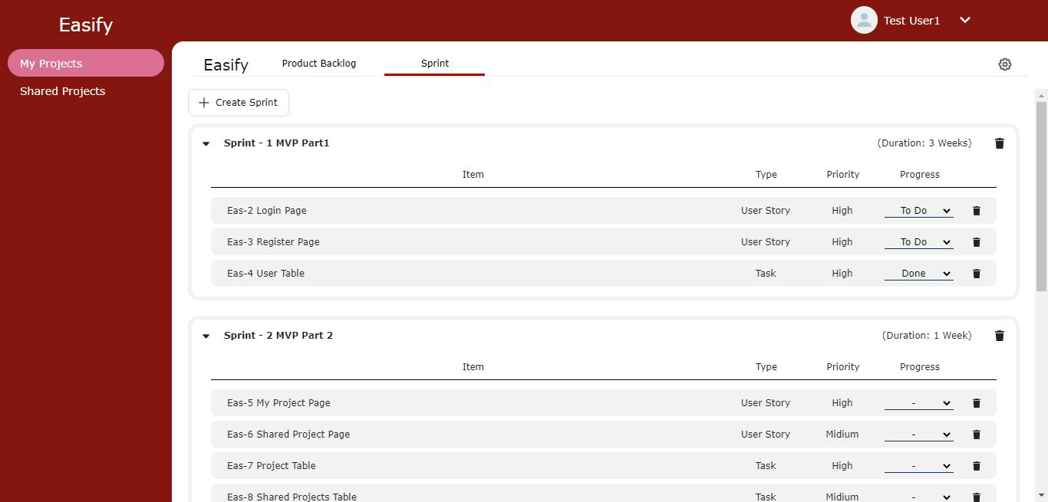
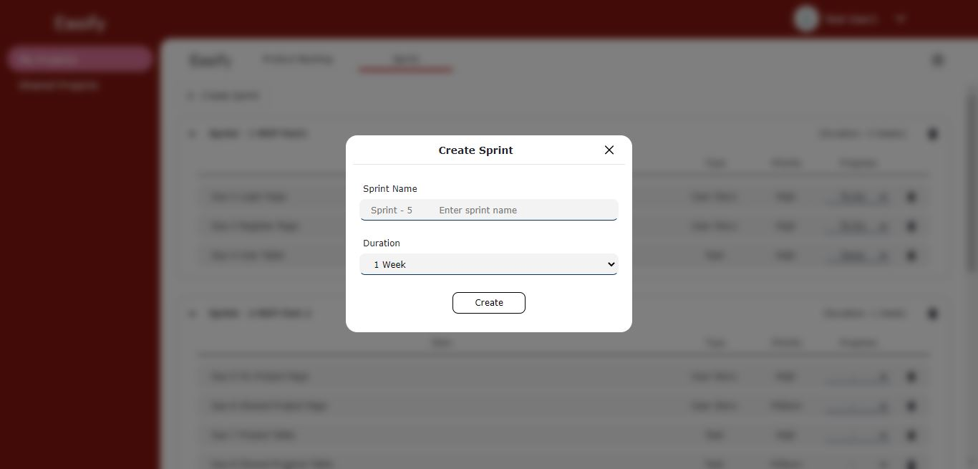
Sprint - 4: Results
Sprint Page
Create Sprint

Slide 19
Sprint 4
Sprint 5
Completed feature: Sprint
Developed backend APIs for Sprint feature to develop its front-end
Linked the front-end with product backlog feature
So that Easify users can add items from the product backlog to sprint backlog
Completed feature: Calendar
We developed the front-end and back-end for Calendar feature
Easify users can now create events by providing date range, title and description to plan their work
Also modify events by dragging from one date to another.

Slide 20
Improvement from the Professor’s Feedback
From the previous presentation , we discussed and decided to change the retrospective as we expected retrospective to be as team’s perspective.
We wrote as team’s perspective and also found all the answers that were left in the retrospective.
We contributed as team.

Slide 21
Product Backlog
We have not included any new user stories to Product Backlog
Tasks included in product backlog for sprint 5:
EAS-62: Develope Calendar screen
EAS-63: Design backend APIs and controllers to perform CRUD operations on calendar events data
EAS-64: Integrate Calendar with Project screens and APIs
EAS-65: Testing for Sprint - 5
EAS-66: Create presentation for Deliverable - 5
EAS-67: Create presentation video and demo for Deliverable - 5
EAS-68: Update Tech Paper
EAS-69: Update Github Wiki

Slide 22

Sprint 5

Slide 23
Sprint - 5: Committed and Completed Artifacts
EAS-25 Points - 5
Total 10 Story Points
100% Completed
User Story: As a product owner or scrum master or developer or creator, I want to be able to see the calendar so that I can plan our work
Acceptance Criteria: Given product owner or scrum master or developer or creator is on calendar screen, when he/ she selects any month or date, then system should display details
Tasks
EAS-62: Develope Calendar screen
EAS-63: Design backend APIs and controllers to perform CRUD operations on calendar events data
EAS-64: Integrate Calendar with Project screens and APIs
EAS-65: Testing for Sprint - 5
EAS-66: Create presentation for Deliverable - 5
EAS-67: Create presentation video and demo for Deliverable - 5
EAS-68: Update Tech Paper
EAS-69: Update Github Wiki
EAS-26 Points - 5
User Story: As a product owner or scrum master or developer or creator, I want to be able to add/delete task on any date so that I can put/remove the deadline for that task
Acceptance Criteria: Given product owner or scrum master or developer or creator is on calendar screen, when he/ she click on any date and enter/modify some event, then the system should display the changes made on that date to all users with whom the project is shared

Slide 24
Sprint - 5: Sprint Backlog
ID | Item | Priority | Story Points | Status
EAS-25 | As a product owner or scrum master or developer or creator, I want to be able to see the calendar so that I can plan our work | Mid | 5 | Done
EAS-26 | As a product owner or scrum master or developer or creator, I want to be able to add/delete task on any date so that I can put/remove the deadline for that task | Mid | 5 | Done
EAS-62 | Develope Calendar screen | High | NA | Done
EAS-63 | Design backend APIs and controllers to perform CRUD operations on calendar events data | High | NA | Done
EAS-64 | Integrate Calendar with Project screens and APIs | High | NA | Done
EAS-65 | Testing for Sprint - 5 | Mid | NA | Done
EAS-66 | Create presentation for Deliverable - 5 | Low | NA | Done
EAS-67 | Create presentation video and demo for Deliverable - 5 | Mid | NA | Done
EAS-68 | Update Tech Paper | Mid | NA | Done
EAS-69 | Update Github Wiki page | Mid | NA | Done

Slide 25
Sprint - 5: Test Cases
User Story ID | Feature | Test Case | Expected Output | Actual Outcome | Status
EAS-25 | Calendar | User is on calendar screen | User should be able to see the calendar and events | User is able to see the calendar and events of that project | Pass
EAS-26 | Calendar | User modify some event on calendar screen | Event should be updated in database | User is able to create and change the date, title and description of the event | Pass

Slide 26
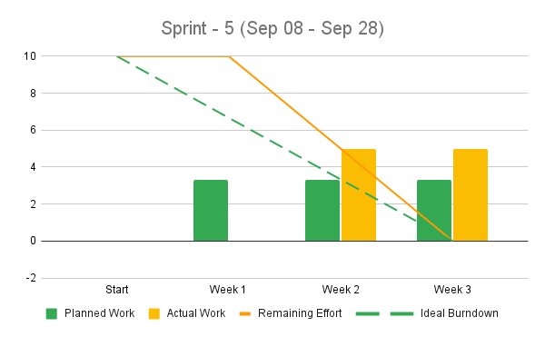
Sprint - 5: Burndown Chart
Week 1
No User Story
Week 2
1 User Story EAS-25 (SP 5)
Week 3
1 User Story EAS-26 (SP 5)

Slide 27
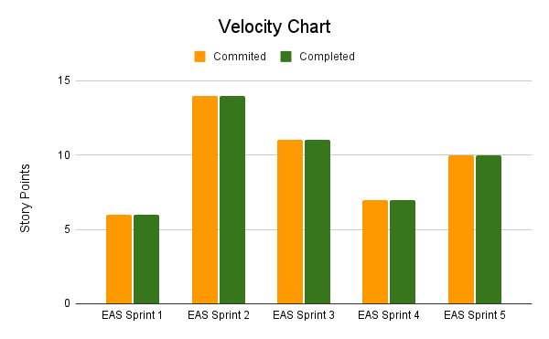
Velocity

Slide 28
Retrospective
What went well
Eager to work with new technology
We are working remotely but we are pairing good
What can be improved
Need to work in timely manner to achieve committed tasks
Time estimation for each task can be improved
Action items
Time estimation of each task

Slide 29
Sprint - 6 User Stories
Total 15 Story Points
EAS-22 Points - 5
EAS-23 Points - 5
User Story: As a developer or creator, I want to be able to upload the images related to work so that I can save my outcome or a problem
Acceptance Criteria: Given developer or creator is on image sharing screen, when user click on upload image and try to upload image from personal device, then system should accept image file
User Story: As a scrum master or creator, I want to be able to create the burndown chart for the project so that we can predict our efforts
Acceptance Criteria: Given scrum master or developer or creator is on chart screen, when he/ she clicks on burndown chart, then system should ask some details and generate burndown chart
EAS-24 Points - 5
User Story: As a product owner or scrum master or creator, I want to be able to create user activity map for the project so that I can understand the user activities better
Acceptance Criteria: Given product owner or scrum master or creator is on chart screen, when he/ she clicks on user activity map, then system should generate user activity map

Slide 30
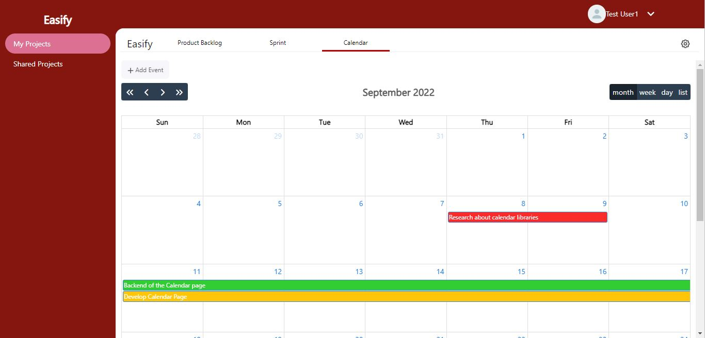
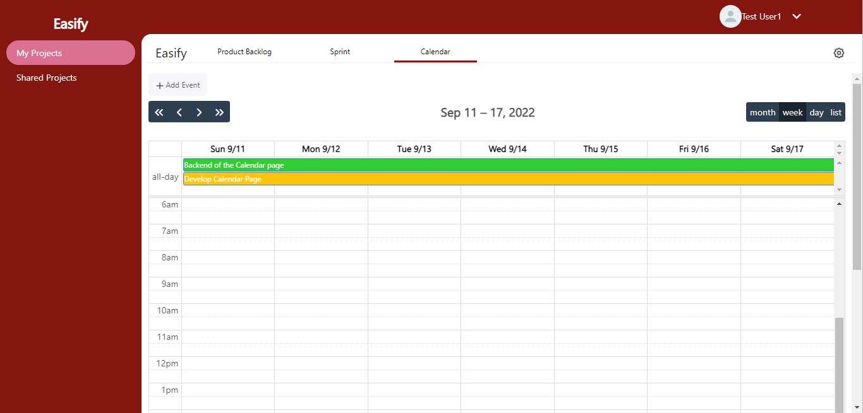
Sprint - 5: Results
Calendar Month View
Calendar Week View

Slide 31

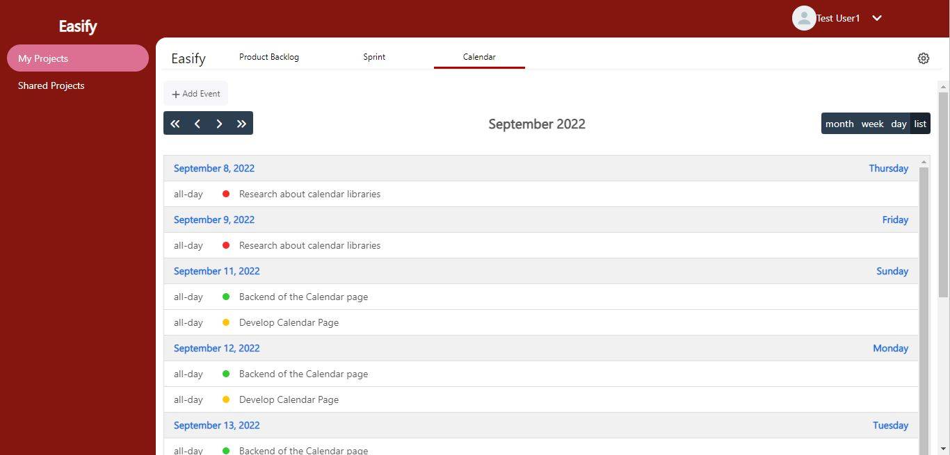
Sprint - 5: Results
Calendar Day View
Calendar List View

Slide 32
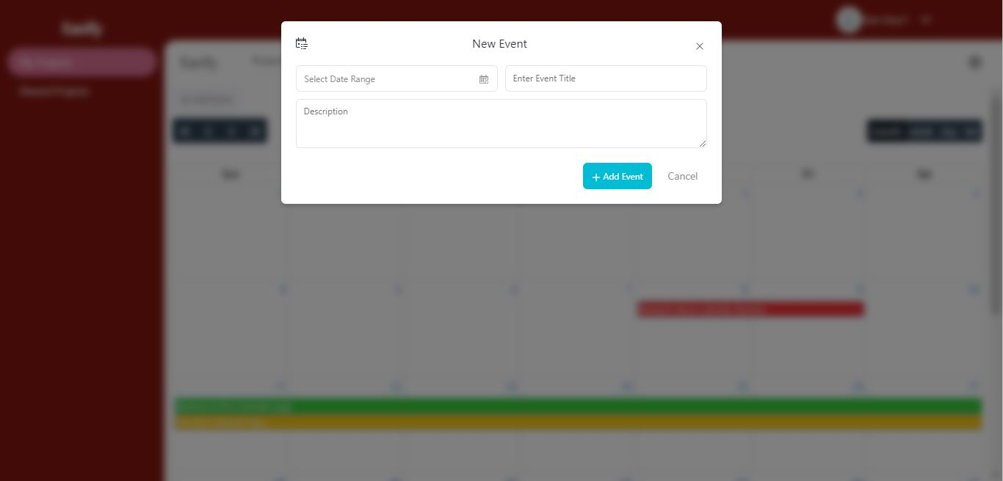
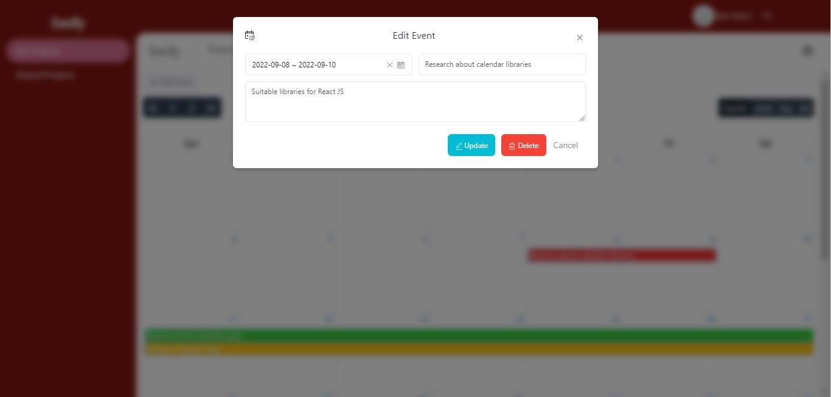
Sprint - 5: Results
Calendar Add Event
Calendar Update-Delete Event

Slide 33
Sprint - 5: Backend APIs
We have developed following APIs in order to complete Calendar feature:
To create event: ‘/api/event/create’ POST
To fetch event: ‘/api/event/fetch’ POST
To update event: ‘/api/event/update’ POST
To delete event: ‘/api/event/delete’ POST

Slide 34

Group Wiki
https://github.com/DV192/Stonecrusher/wiki

Slide 35
Thank You

